Slide 1
GraphQL on ASP.NET Core
WITH

Slide 2
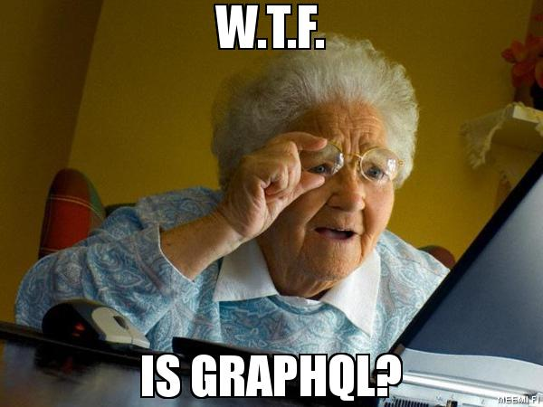

Slide 3

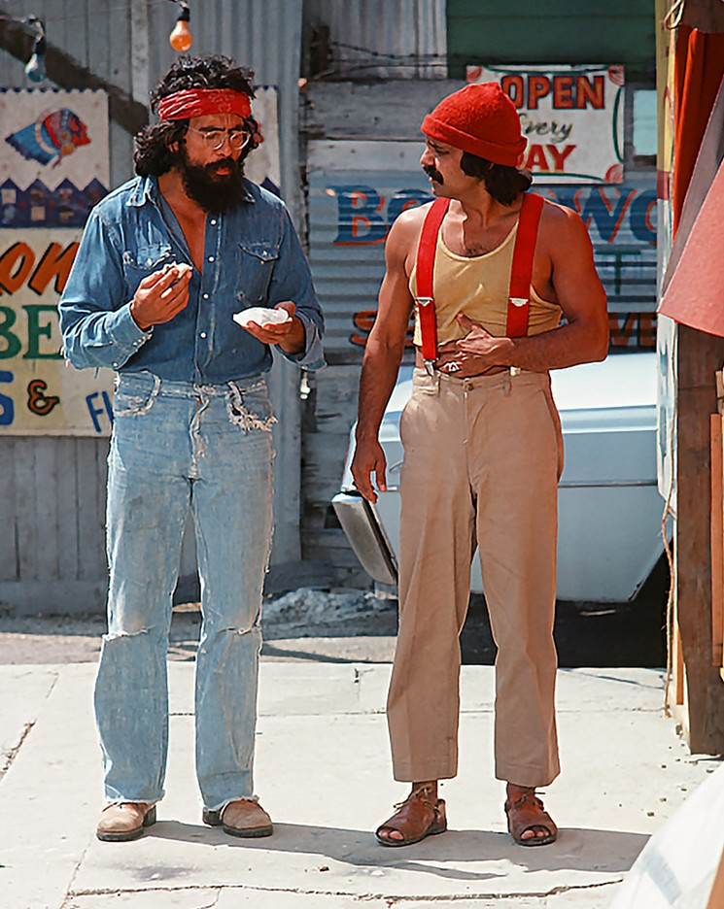
Who are we?

Slide 4

Who is this for?
Who is this for?

Slide 5
Demo

Slide 6



Slide 7
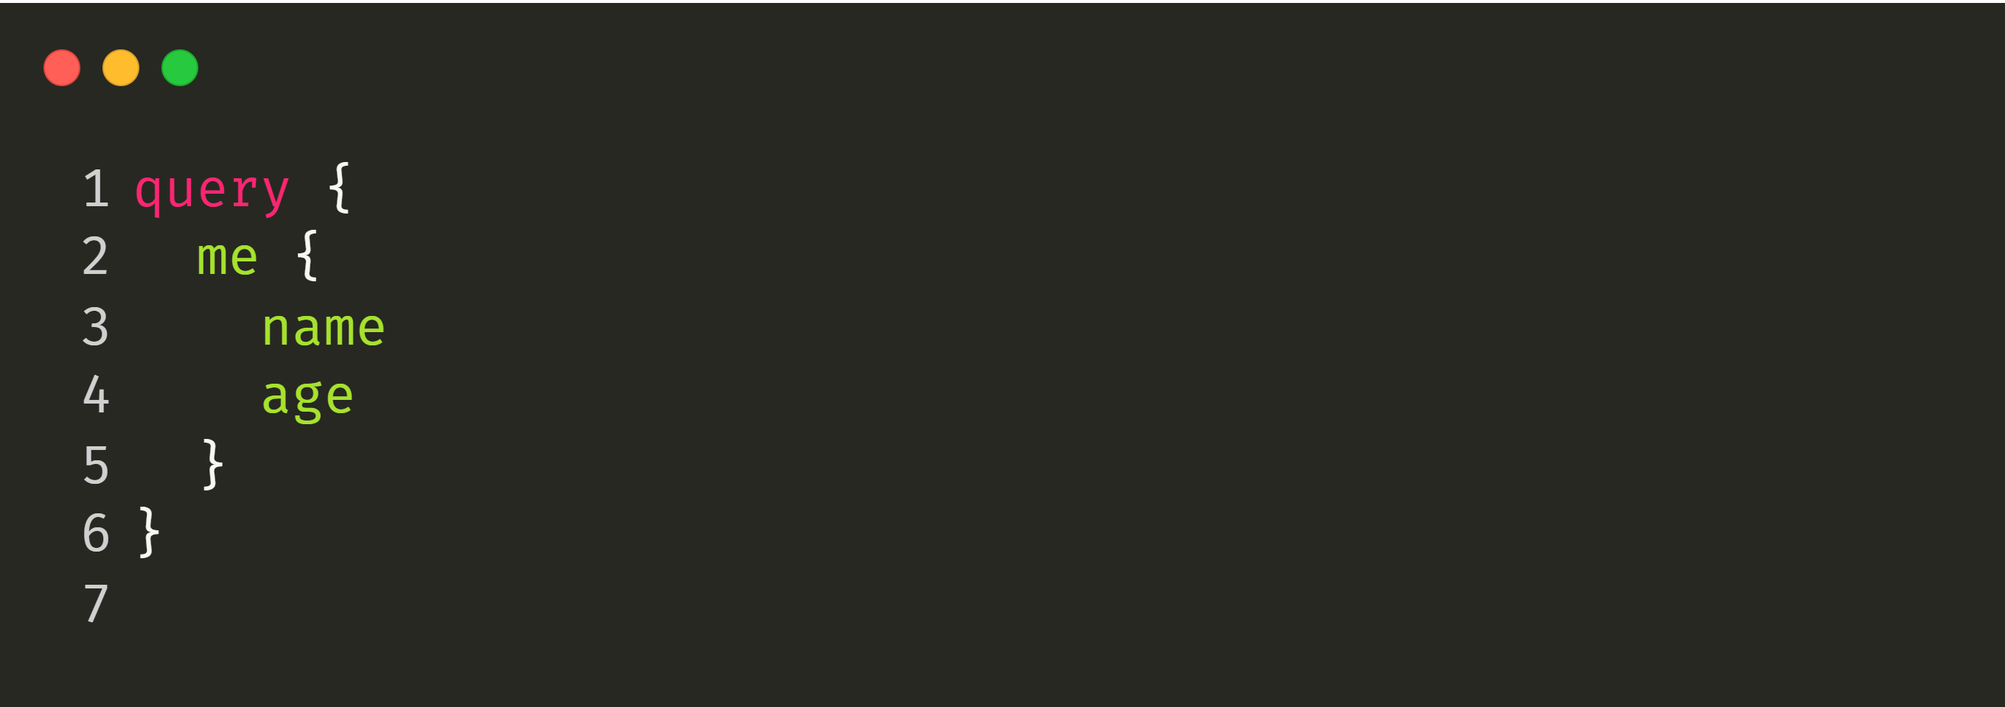
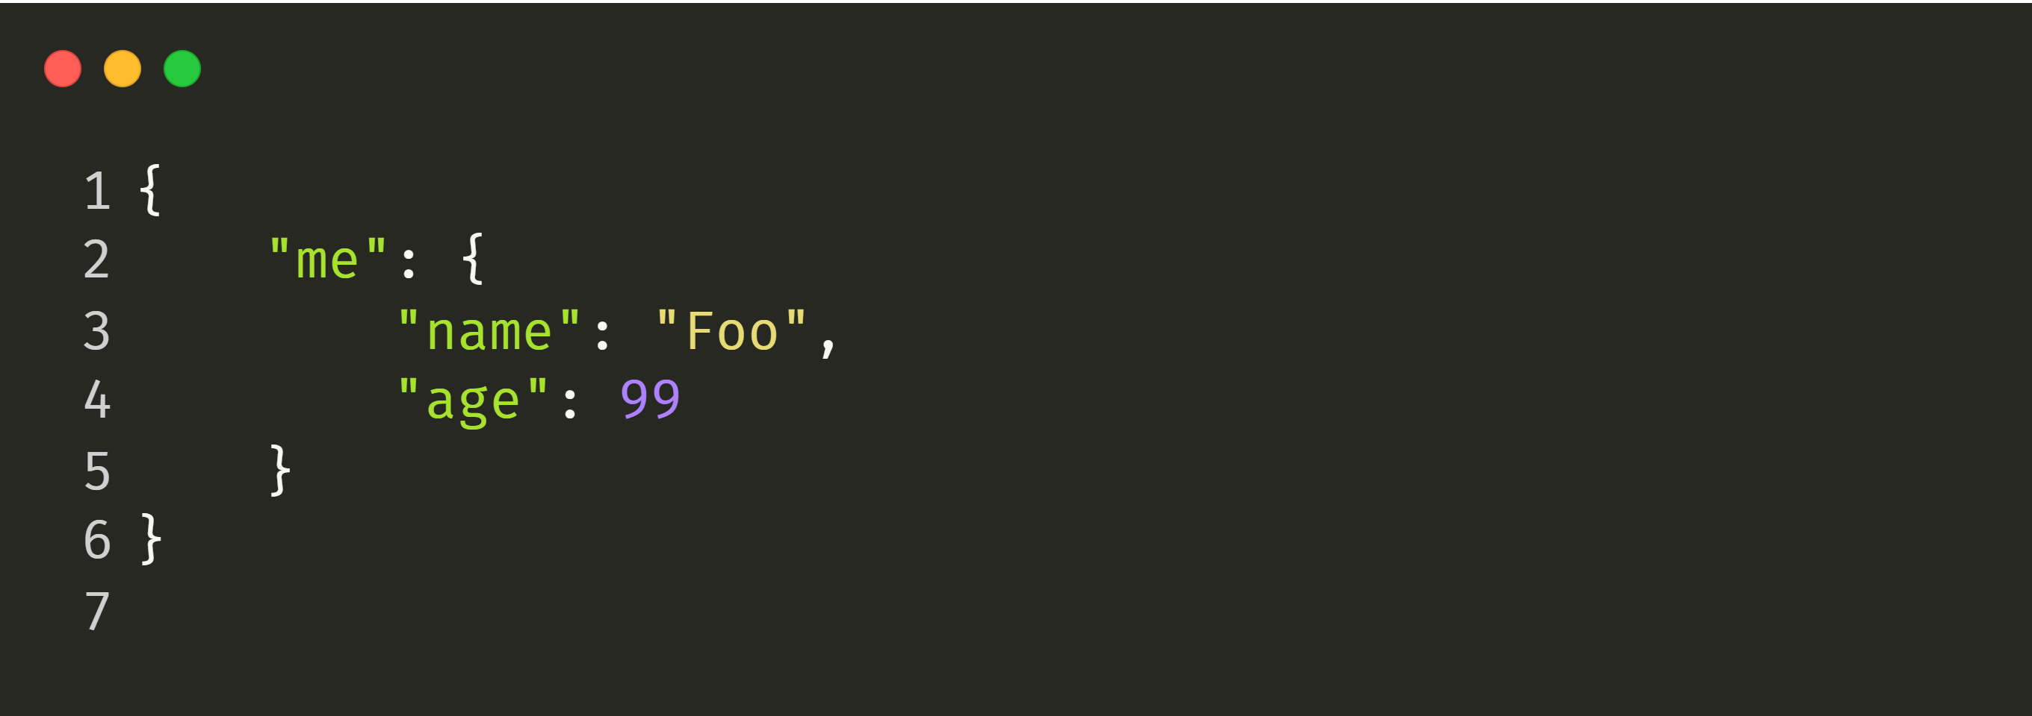

Slide 8
GET https://webservices.amazon.com/onca/xml?
Service=AWSECommerceService&
AWSAccessKeyId=mY-Sup3r-s3cr3!-k3y&
AssociateTag=12345&
Operation=ItemLookup&
ItemId=0316067938&
ResponseGroup=Reviews&
TruncateReviewsAt=256&
IncludeReviewsSummary=False&
Version=2013-08-01&
Timestamp=[YYYY-MM-DDThh:mm:ssZ]&
Signature=[Request Signature]
Notes:
https://www.ics.uci.edu/~fielding/pubs/dissertation/rest_arch_style.htm

Slide 11
What is GraphQL?

Slide 12
GraphQL
One Endpoint
No over- or under-fetching
Simplicity
Real-time
Predictability
No versioning
One Request
Type System
Documentation

Slide 13
Demo

Slide 14
Read | Query | GET
 |  | PUT, POST, PATCH DELETE
Events | Subscriptions | N/A
Write | Mutation | PUT, POST, PATCH DELETE
Operation | GraphQL | REST

Slide 15
Demo

Slide 16
What GraphQL is not:
Graph database query language
Solution for binary streams
Facebooks version of OData
Bound to a specific data source
Limited to HTTP
Limited to the JavaScript world

Slide 17
Challenges with GraphQL:
Fetching data in a consistent way throughout your graph
Scaling a single graph to multiple projects
Estimating the performance impact of requests
Implementing rate-limit

Slide 18
Fetching Data

Slide 19
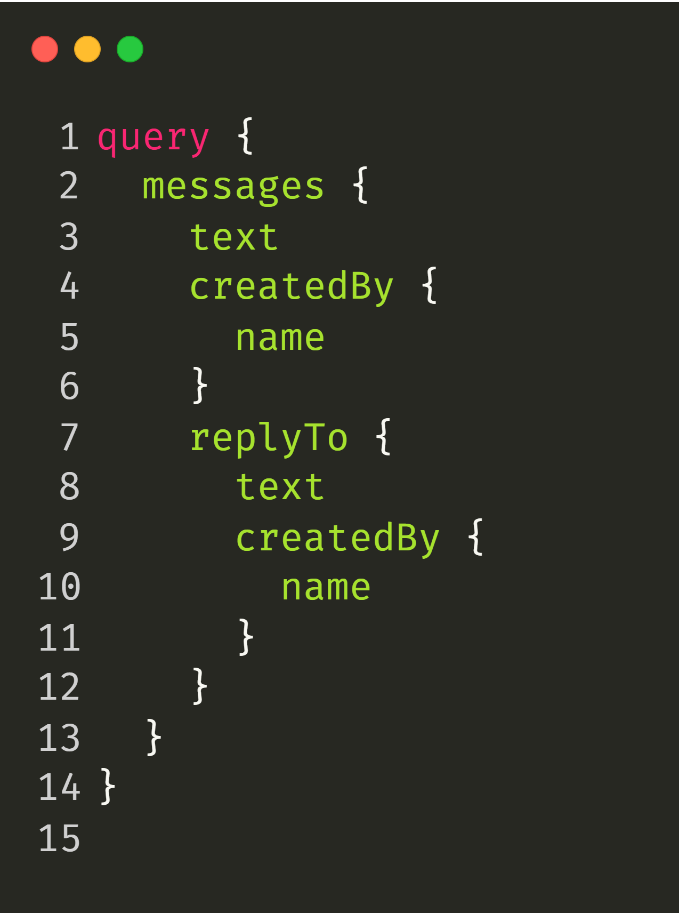

Slide 20


Slide 21
DB
Resolver
Resolver
Resolver
Resolver
DataLoader
Resolver
Resolver
Cache
Resolver
Resolver
Resolver
Resolver
Resolver

Slide 22
Demo

Slide 23
Scaling Your Graph

Slide 24
High Bandwidth Usage
GraphQL Client
{
"query" : <query>
}
GraphQL Server

Slide 25
Unrestricted Query Execution
GraphQL Client
{
"query" : <query>
}
GraphQL Server

Slide 26
Low Bandwidth Usage
GraphQL Client
{
“id” : “W5IYenw==”
}
GraphQL Server
Middleware

Slide 27
Restricted Query Execution
GraphQL Client
{
“id” : “W5IYenw==”
}
GraphQL Server
Middleware

Slide 28
Demo

Slide 29
Conclusion:
GraphQL is a great way to expose API in a more human-readable way
Data fetching and aggregation is moved into the server
Type system protects the consumer from malformed data
Introduces new challenges for scaling your APIs
GraphQL is NOT always a good solution (Binary Streams)

Slide 30
Outlook

Slide 31
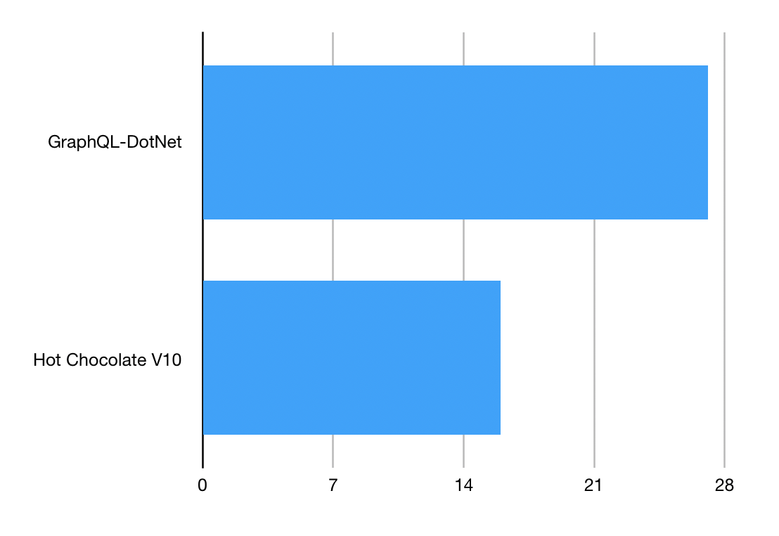
Speed:

Slide 32
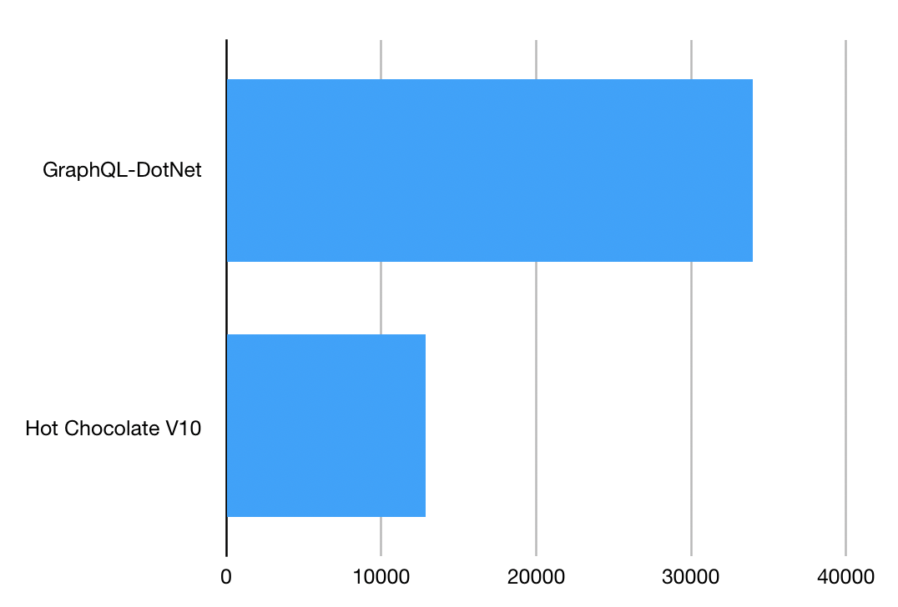
Memory:

Slide 33
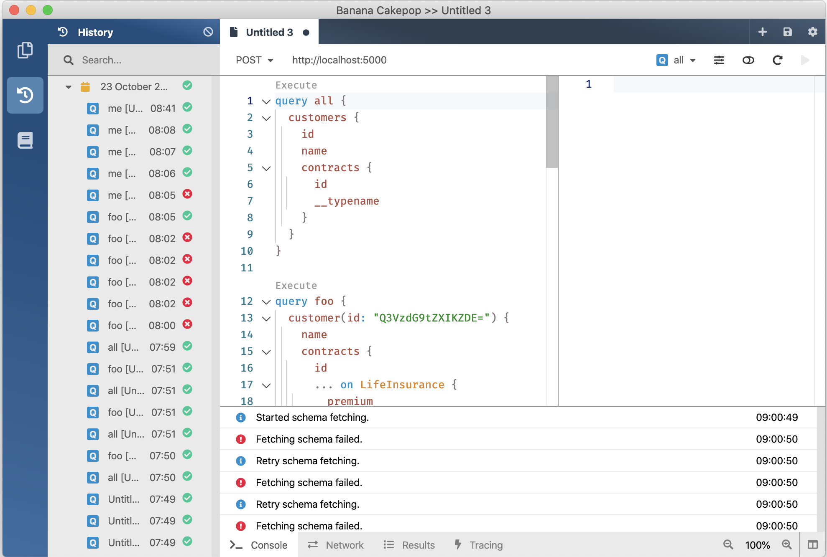
V10
GraphQL Gateway
V11 January 2020
V12 August 2020
GraphQL Client
GraphQL Server
Developer Tooling
Supports Blazor and Xamarin
Execution Plans @defer @stream
Schema Registry (Schema Change Tracking, CI Tools)
Automatic Database Mapping
GraphQL Analytics
Operations Manager (Execution Plan Store, Whitelisting, Client Registry)

Slide 34
Where do you find us?
https://hotchocolate.io
https://chillicream.com
https://github.com/ChilliCream/ApexVox2019
https://twitter.com/Chilli_Cream
https://github.com/ChilliCream

